Slide 1
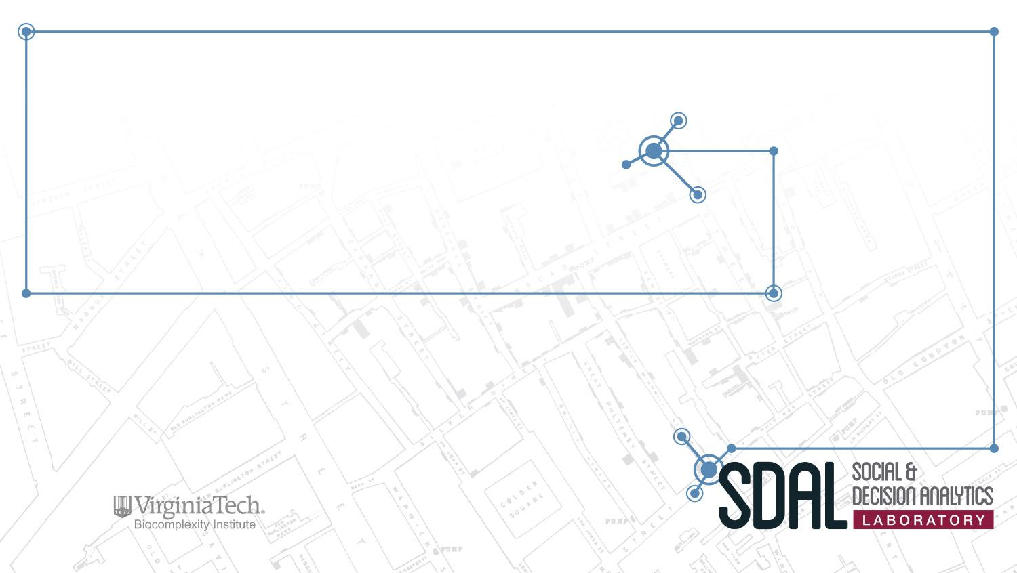
Alcohol-Related Crime Reduction Strategies for Restaurants and Nightlife in Arlington (ACPD)
PI: Gizem Korkmaz
SDAL Team: Aaron Schroeder
Team: José Bayoán Santiago Calderón, Hannah Brinkley, Alexa J. Nosal, and Kelsey McMahon
Sponsor: Jim Mastoras, Arlington County Police Department
Notes:
Hannah
This is the Alcohol-Related Crime Reduction Strategies project led by Gizem Korkmaz and Aaron Schroeder. This project is sponsored by Jim Mastoras from the Arlington County Police Department.

Slide 2
Introduction contd.
“The Police Department’s Arlington Restaurant Initiative was designed to address public safety issues, foster relationships and cooperation with businesses, and ultimately raise the best standards of restaurants that serve alcohol. The goal of the initiative is to develop strategies that will maintain Clarendon as a safe destination for nightlife and entertainment” (2017 Annual Report the Arlington County Police Department).
Best Bar None Goes to Arlington
TIPS (Training for Intervention ProcedureS): a skills-based training program designed to prevent intoxication, underage drinking, and drunk driving.
Partnership with Washington Regional Alcohol Program to offer free rides home via ride-sharing services.
Notes:
Hannah

Slide 3
Project Goals
Problem: evaluate effectiveness of ARI in regards to economic and social impact
Alcohol Related Crime types: drunkenness, DUI, public disorder, etc.
Our focus: heaviest drinking times in Clarendon
Thursday, Friday, Saturday, Sunday
between 9PM - 3AM
Notes:
Hannah

Slide 4
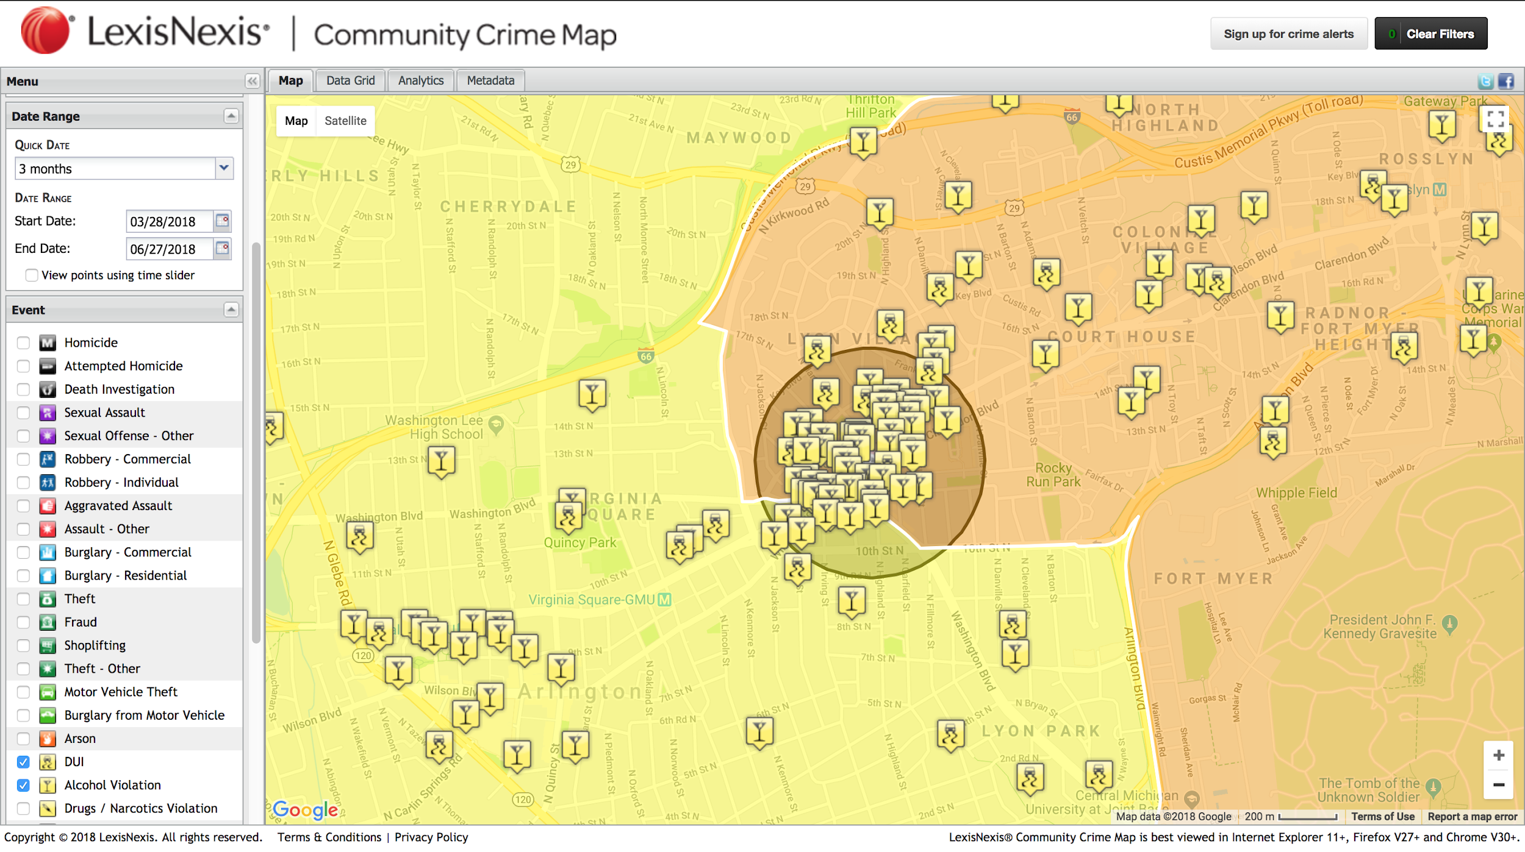
Notes:
Bayoán
We selected the Clarendon Metro Station as the centroid and based on the distribution of alcohol related crimes and police district boundaries decided to consider a quarter mile buffer as the area of interest.

Slide 5
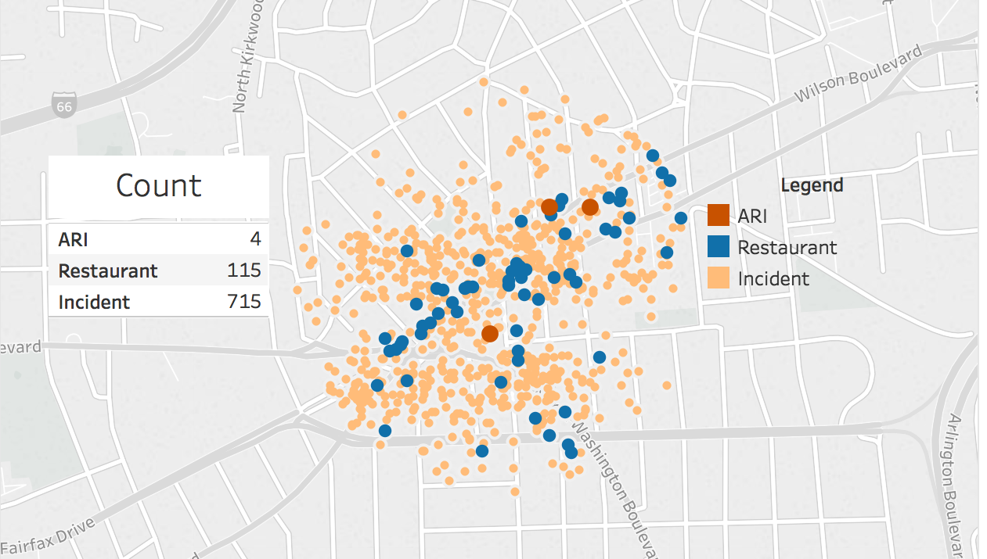
Crime Data & Restaurants
Notes:
Bayoán

Slide 6
Social & Economic Impact Analysis
Social Impact Analysis (SIA)
Captures the effects of policy and regulations on people’s behavior, decisions, quality of life, and community
Better relationship with police (relationship-focused policing)
Community involvement
Safer for residents
Less crime
Economic Impact Analysis (EIA)
Captures the effects of policy and regulations on economic factors such as housing values, average median income, and business revenues
Return on Investment
Reduces likelihood of the restaurant losing their liquor license
Increased sales
Less crime: Avoid arrest, jail and court fees
Both can inform future regulatory actions or interventions based on positive or negative impacts of the policies already implemented (Before & After)
Notes:
Alexa
in order to address the effectiveness of the ARI program, we also need to consider the social and economic impacts
SIA---how the program will impact citizens quality of life in Arlington, example increasing safety during nightlife
-this analysis began last year in the Urban Affairs and Planning Class at Virginia Tech under Dr. Zhang
-her students collected data on other alcohol control programs to begin to make a framework
EIA---How has property tax and sale price been changing?
If safety is increasing, you can expect it to be more expensive
Not expected to change significantly though because it is already quite expensive
Business Effects?
Effects on employment and business growth
Expectations: total employment should increase slightly, and safer environment should help increase people to move and work there
Business Growth
Desirability will increase in Arlington
Increase safety = higher population = higher income

Slide 7
Data Collection
Crime Incidents (Arlington County Data API)
Geocoded, timestamped, incident reports (description)
Social Nightlife
Datetime
Special events - weekends, sport events, holidays, etc.
Social Media
Twitter
Blogs on News
Facebook
ABC
Spatial Coverage: Virginia - Arlington - Clarendon
Temporal Coverage: 2015-01-01 - Present
Variables: Licensee, Violations, Result (fines, suspension, etc.)
Weather Data (Menne et al. 2012)
Inclement weather
Notes:
Kelsey
Crime incidences disclosure “Arlington County Data API was used for this purpose, but it is not endorsed or certified by Arlington County.”
Speaking notes:
Here is an overview of the data that we have been working with -- green is the data that we have worked with and red is the data that we are going to work with in the future
DATA WE’VE WORKED WITH
For crime incidents we were looking at the crime data that we geocoded for the clarendon area and had descriptions of, like DUI, Drunk in Public, Traffic and Parking violations, etc. We are looking how these were affected by weekends and special events like a football game or St. Patricks day or something like that
From social media, we did some scraping to see the public perception of the Arlington police department. We looked at sites like the ACPD website, comments on articles related to alcohol in arlington (for example, an article about parking zones being added at peak times), and also twitter and facebook posts that mention the ACPD or the Clarendon bar scene
DATA WE ARE GOING TO WORK WITH
For the ABC data that we are going to collect we made sure the data was in the clarendon area as well and we are looking from a time period of January 1st 2015 to the present in order to determine the ABC violations that restaurants in this area have committed. This was to see if the restaurants that implemented the Arlington Restaurant Initiative had less violations during the years that they were involved in the program.
The last data set we are going to take a look at is weather data in the area, because inclement weather could affect the amount of people going out on a certain day

Slide 8
Exploratory Data Analysis (EDA)
Frequency of Alcohol Related Crimes 2015 - 2017
Year | Assault | Disorderly Conduct | Drunk in Public | DUI | Sexual Assault | Underage Drinking / Fake ID | Traffic / Parking Violation
2015 | 92 | 22 | 176 | 40 | 2 | 1 | 171
2016 | 74 | 41 | 188 | 51 | 7 | 2 | 177
2017 | 35 | 6 | 162 | 27 | 9 | 0 | 0
Notes:
Kelsey
This is the frequency of alcohol related crimes from 2015 to 2017 from our Crime incidents data.
Every category except sexual assault and drug possession have decreased for the year of 2017.
The categories we really want to focus on are drunk in public, DUI, and traffic and parking violations.
Drunk in public increased in 2016 but got to its lowest point in three years at 162 incidents in 2017.
The same thing happened for incidents of DUI; it increased in 2016 and decreased to its lowest the next year.
One of the most important things that we found were that there are ZERO traffic and parking violations for 2017.
This was mostly likely due to the fact that the police blocked off certain sections of road where the parking violations were the most problematic.
We found this to be incredibly informative in regards to the effectiveness of the police dealing with the increased populations in Clarendon during peak times.

Slide 9
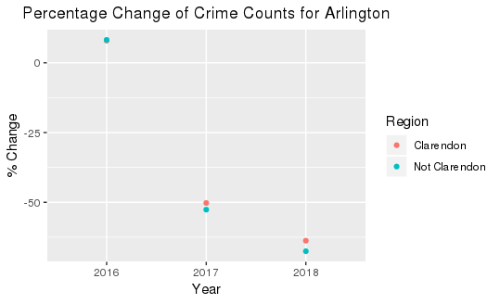
Initial EDA
Notes:
Crime incidences disclosure “Arlington County Data API was used for this purpose, but it is not endorsed or certified by Arlington County.”
this scatterplot shows the percent change of alcohl-related crime incidents that occurred both within the Clarendon area as well as outside the Clarendon area
the goal was to make a visualization that crime incidents have gone down after the ARI program was implemented but as you can see it also has gone down outside the Clarendon area since ARI

Slide 10
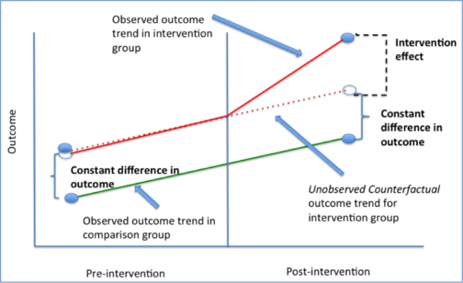
Proposed Methods: Difference-in-Difference [DID]
DIFFERENCE-IN-DIFFERENCE (DID) is used to estimate the policy effect by comparing the changes in outcomes over time between a population that is enrolled in a program (the treatment group) and a population that is not (the control group).
Source: Columbia University Mailman School of Public Health
Notes:
Bayoán

Slide 11
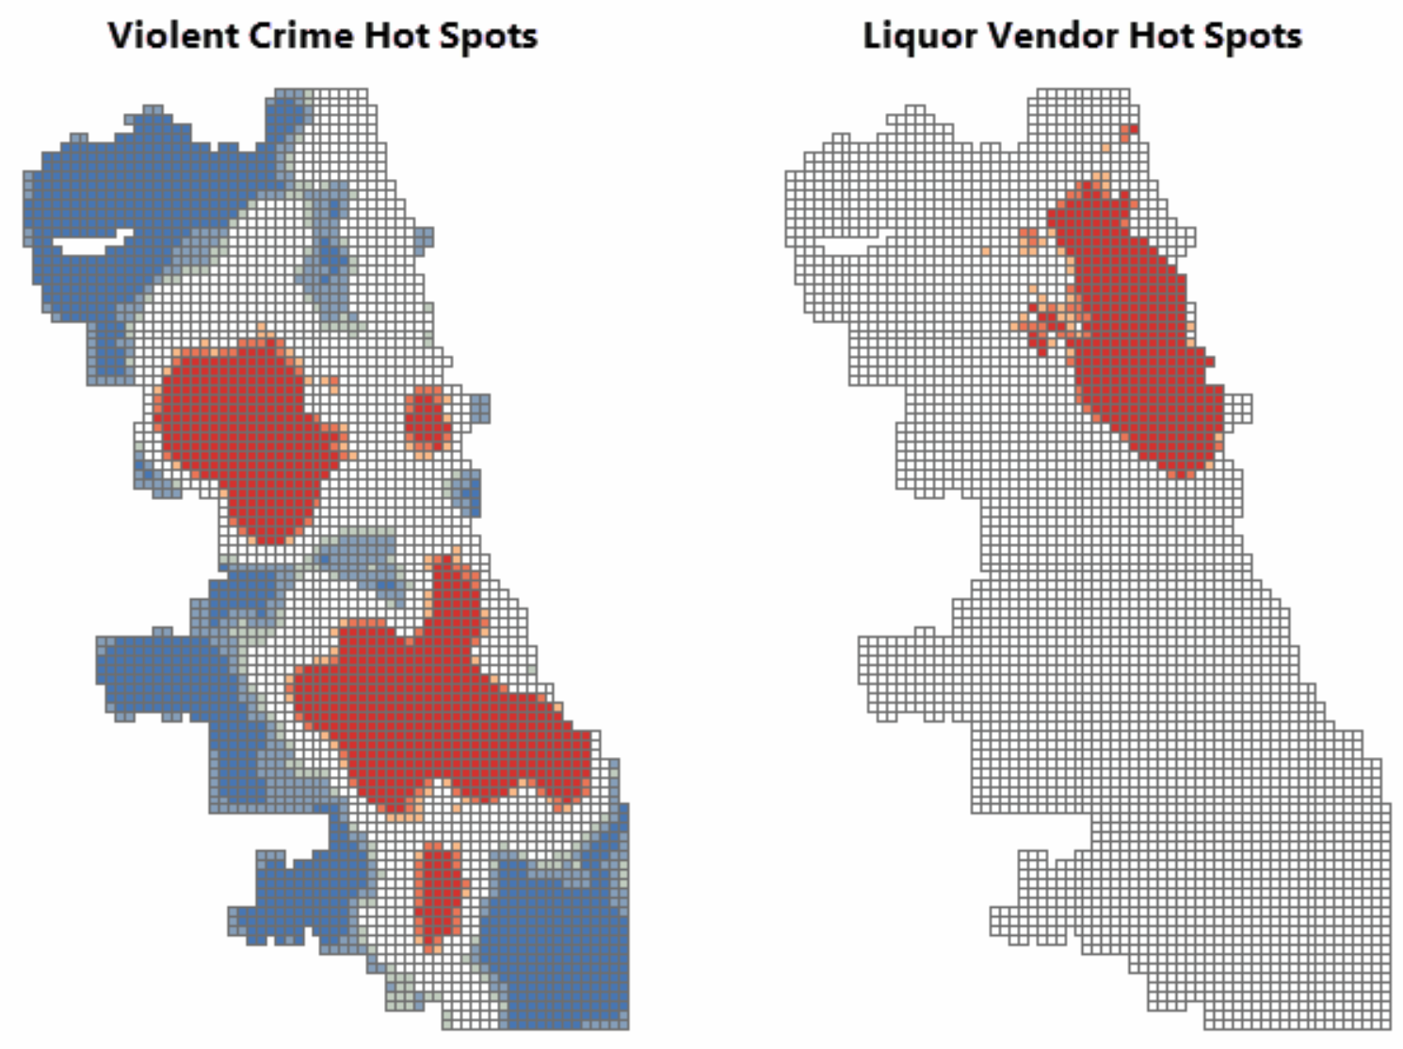
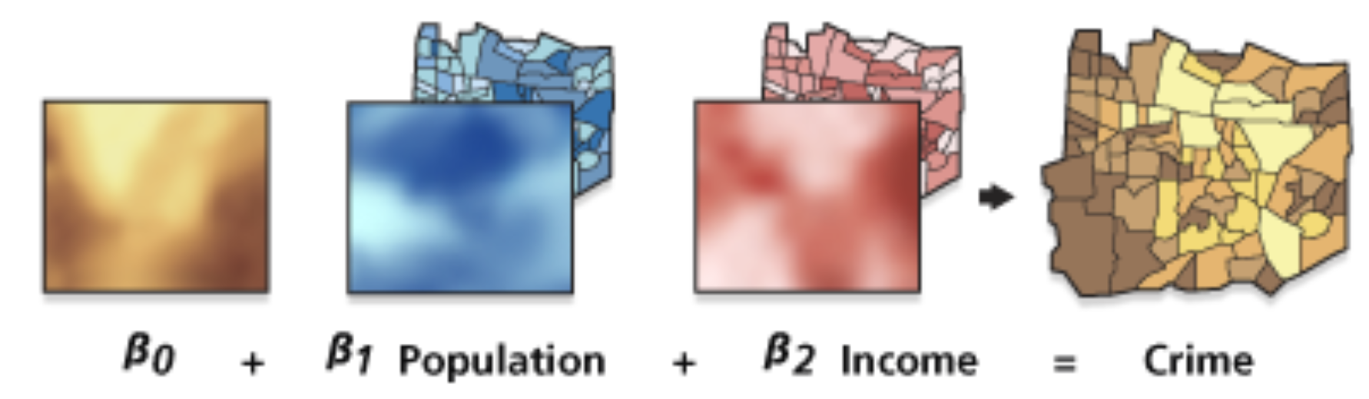
Proposed Methods: Hotspot Analysis and GWR
Source: ESRI Documentation
“A shaded area (C), such as one used in a choropleth map, also suggests equivalent risks of crime throughout the area with a dramatic reduction in risk at the border. It suggests that police activity throughout the area is appropriate” (Eck et al. 2005).
Notes:
Bayoán
Our proposed methods are those frequently found in the literature. For example, hotspot and geographic weighted regression analysis are techniques often used in the field for exploiting the spatial and temporal variation. These methods can identify trends and correlations (e.g., the effect of the program in the alcohol-related crimes incidence).

Slide 12
Strategy Going Forward
Compare Clarendon incident data before and after the Arlington Restaurant Initiative accounting for maturation effects (hotspot analysis)
Perform EDA to learn patterns in the data (social nightlife, special events, inclement weather)
Estimate impact of the program on alcohol-related crimes
Analyze the second-degree economic and social effects
Build dashboard for visualizing the data and analysis
Notes:
Bayoán
Crime incidents disclosure “Arlington County Data API was used for this purpose, but it is not endorsed or certified by Arlington County.”

Slide 13
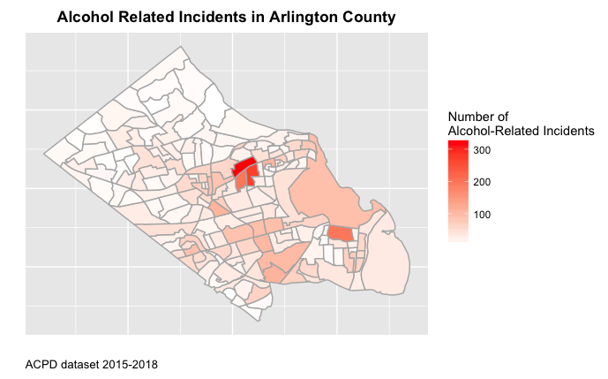
Combined ArlingtonACS data and filter crime_incidence data from the SDAL database
Heat map shows generalized areas in all of Arlington County by average count of alcohol-related incidents
Notes:
Alexa

Slide 14
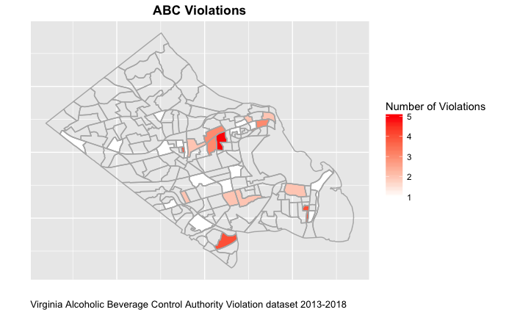
Used block groups from ArlingtonACS data and merged with cleaned ABC violation data
Created heat map to generally visualize the areas in Arlington County of restaurants with ABC licenses that had at least 1 alcohol license violation
Notes:
Alexa

Slide 15
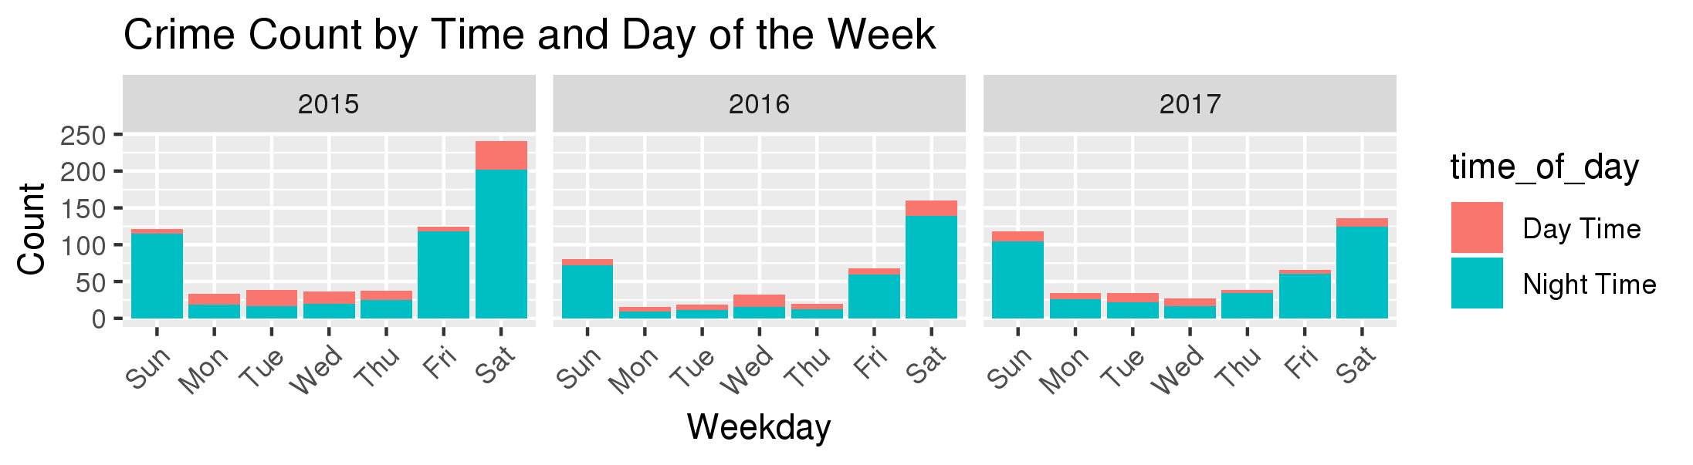
Relevant Days and Times
Using the Crime Incidents data, we created three histograms, one per year of data, to see when the most alcohol-related crimes are committed
Days: Friday, Saturday, and Sunday, which eliminated our previous prediction that Thursday would need to be included in our analysis
Times: the histograms showed the huge disparity between rate of crime during the daytime and nighttime, with the majority of these crimes being committed during the evening/night
Notes:
Alexa--
TIME OF DAY:
Morning: 03:01-09:00
Midday: 09:01-15:00
Evening: 15:01-21:00
Night: 21:01-03:00

Slide 16
Tableau Point Map
Merged dataset that had list of restaurants with ABC violations with the list of restaurants in Arlington County with ABC licenses
Filtered map down to focus on the restaurants within 0.25 mile radius from the clarendon metro station
Restaurants are color coded based on count of violations
I still need to filter by year since some of the violations still date back to 1993
What years should I be focusing on ?
**don’t know how to link Tableau since it was created on my local computer server
Notes:
Alexa

Slide 17
Other materials we can add:
Cost-estimation
Holiday/special event data
Anything hannah and bayoan want to add that they have done

